Slide 1
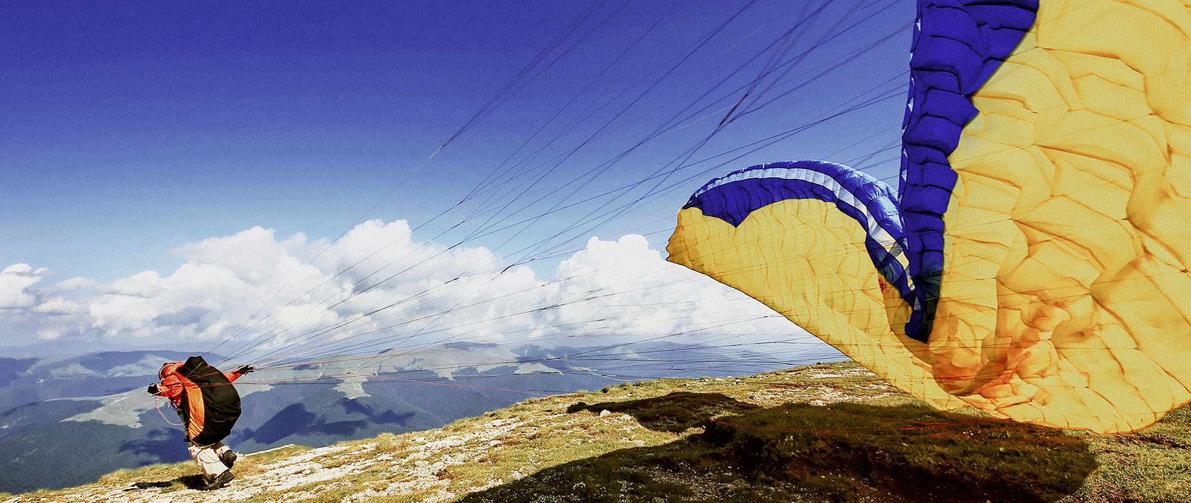
Title of this presentation
(Sub)title of this presentation
Name of department and/or author
Month 2021

Slide 2

Title of this presentation
(Sub)title of this presentation
Name of department and/or author
Month 2021

Slide 3
Title of this presentation
(Sub)title of this presentation
Name of department and/or author
Month 2021

Slide 4
Title of this presentation
(Sub)title of this presentation
Name of department and/or author
Month 2021

Slide 5
Title of this divider
(Sub)title of this divider or remove this bar

Slide 6

Title of this divider
(Sub)title of this divider or remove this bar

Slide 7
Example index/agenda
The quick brown fox jumps
The quick brown fox jumps over the lazy dog
The quick brown fox jumps over the lazy dog
The quick brown fox jumps and jumps over the very lazy dog
The quick brown fox jumps over the lazy dog
The quick brown fox jumps

Slide 8
Example text lay-out
The quick brown fox jumps over the lazy dog
The quick brown fox jumps over the lazy dog. The quick brown fox. The quick brown fox jumps over the lazy dog. The quick brown fox jumps. The quick brown fox jumps over the lazy dog.
The quick brown fox jumps over the lazy dog. The quick brown fox. The quick brown fox jumps over the lazy dog. The quick brown fox jumps.
The quick brown fox jumps over the lazy dog. The quick brown fox. The quick brown fox jumps over the lazy dog. The quick brown fox jumps. The quick brown fox jumps.
The quick brown fox jumps over the lazy dog. The quick brown fox. The quick brown fox jumps over the lazy dog. The quick brown fox jumps.

Slide 9

Example bullet points / text lay-out
Using bullets with indent button
Use the indent button to create the text levels with the appropriate bullet.
The quick brown fox jumps over the lazy dog
  The quick brown fox jumps over the lazy dog. The quick brown fox jumps.
    The quick brown fox jumps over the lazy dog. The quick brown fox jumps over the lazy dog. The quick brown fox jumps over the lazy dog.
      The quick brown fox jumps over the lazy dog. The quick brown fox jumps over the lazy dog. The quick brown fox jumps over the lazy dog.
        The quick brown fox jumps over the lazy dog. The quick brown fox jumps over the lazy dog. The quick brown fox jumps over the lazy dog.

Slide 10








Follow us
Add text or remove this bar
ing.com
@ING_News
LinkedIn.com/company/ING
SlideShare.net/ING
Medium.com/ing-blog
ingwb.com
Facebook.com/ING
YouTube.com/ING
Flickr.com/INGGroup

